Slide 1
Insurance Analytics Project Group 3

Slide 2





Meet our Team
Rucha
Shashank
Gunjan
Deepthi
Swapnil
Pratham

Slide 3



BUSINESS PROBLEM and AGENDA (Insurance Analytics)
01
GOALS
Optimizing Claims Settlement Efficiency & Customer Satisfaction
02
OBSERVATIONS
Leverage claims and policy data to identify the key drivers of claims processing delays.
predict the optimal settlement path for different claim types, and forecast expected settlement times.
03
IMPACT
Streamline the claims journey, reduce average settlement duration.
Improve customer satisfaction through proactive communication and efficient resolution.

Slide 4
KPIs considered
Total claim amount
Total Premium Amount
Total
policies
Policies expiring this year
Policy type wise premium amount
Product group wise total revenue
Payment status wise policy count
Premium growth rate
Age bucket wise policy count
Gender wise policy count
Claim status wise policy count
Policy type wise policy count

Slide 5
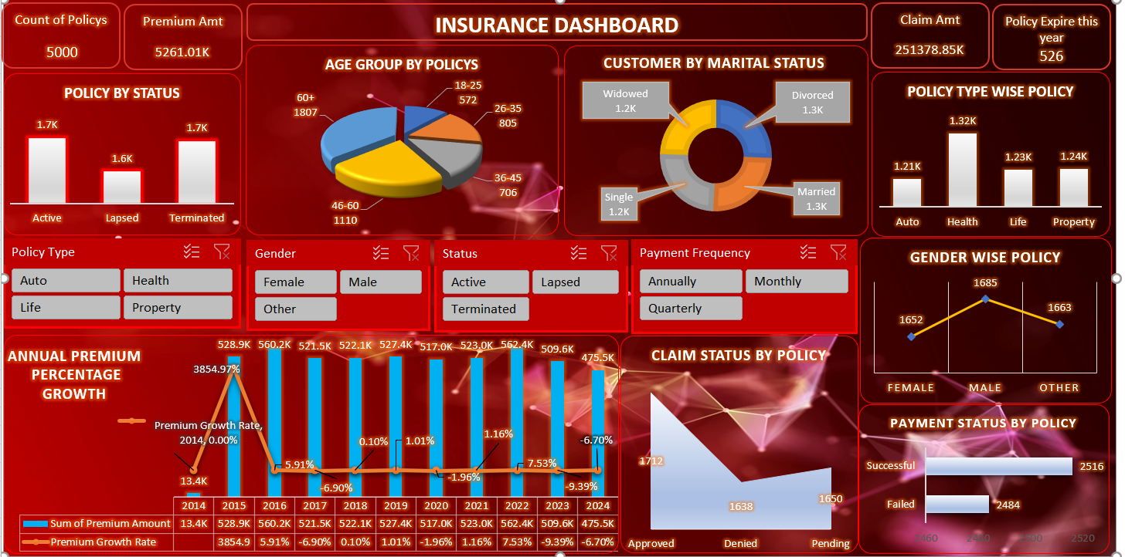
Excel dashboard

Slide 6
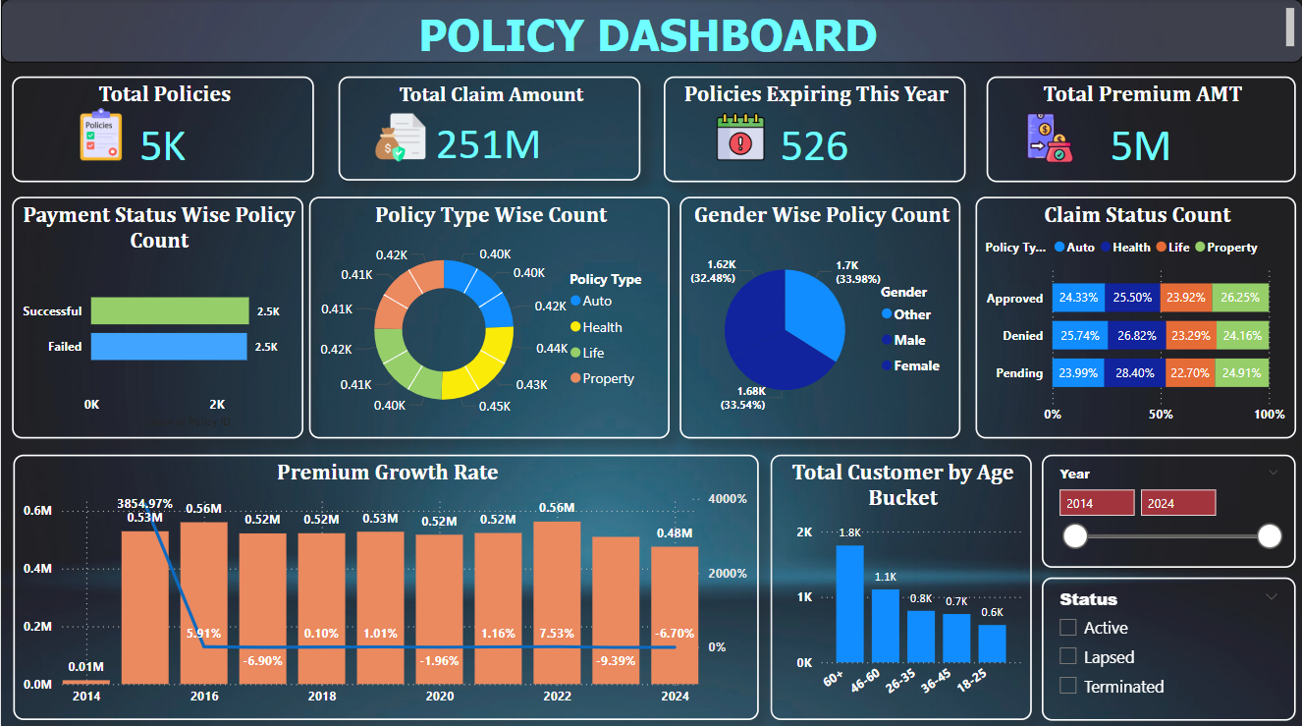
Power bi dashboard

Slide 7
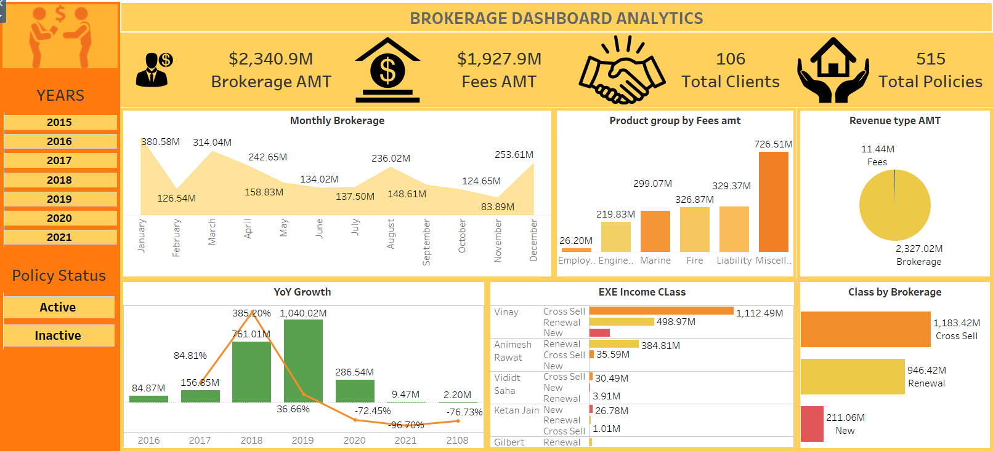
Tableau dashboard

Slide 8
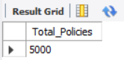
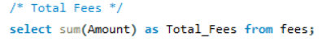
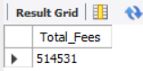
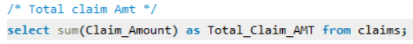
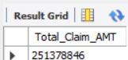
MYSQL Queries
1. Total Policies:
2. Total Fees
3. Total Claim Amount

Slide 9
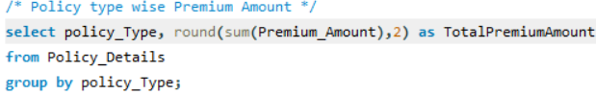
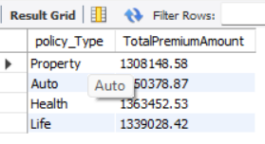
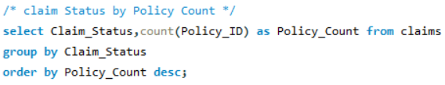
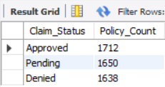
4. Policy Type wise premium count
5. Claim status wise policy count

Slide 10
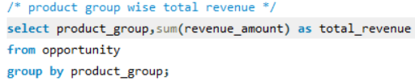
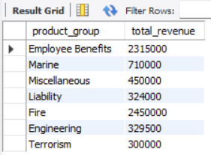
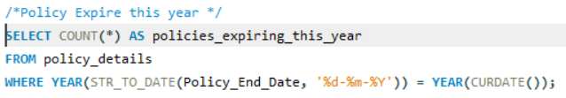
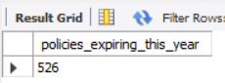
6. Product wise total revenue
7. Policies expiring this year

Slide 11
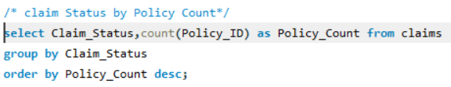
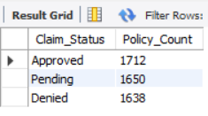
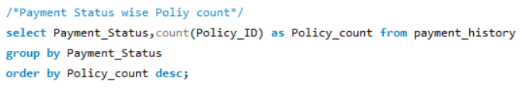
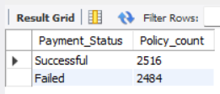
8. Claim status wise policy count
9. Payment status wise policy count

Slide 12
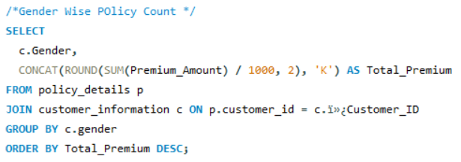
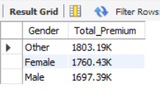
10. Gender wise total premium amount

Slide 13
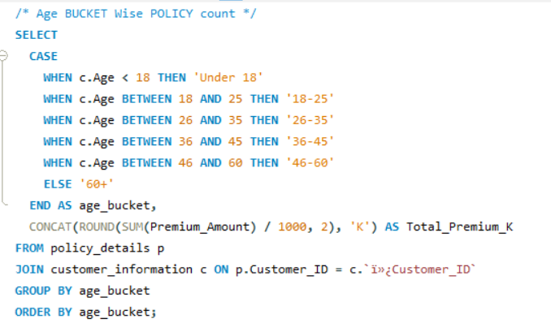
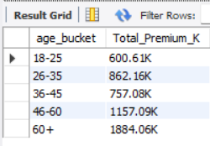
11. Age bucket wise total premium amount

Slide 14
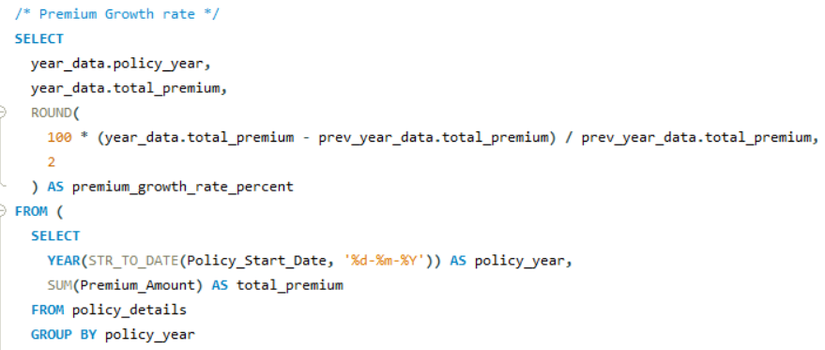
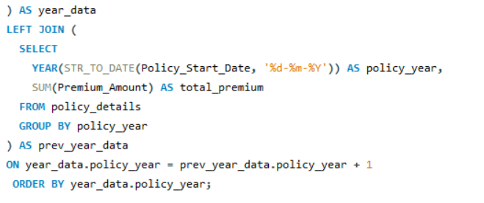
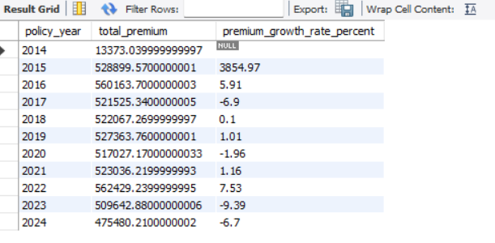
12. Premium Growth Rate

Slide 15

Conclusion & Recommendation
Market Research
Conduct continuous targeted market research to understand emerging customer needs, competitive shifts, and new risk landscapes.
Market research to understand evolving customer needs, emerging risks and competitive landscapes.
Enhance customer service and retention
Prioritize customer retention by delivering a personalized, proactive, and seamless experience.
Train staff on customer engagement and conflict resolution.
Increase in sales
Proactive marketing campaigns offering tailored products that address specific customer needs and emerging risks.
Introduce new insurance products tailored to emerging market.
Improving operational efficiency
Leverage digitalization and AI-powered automation across its value chain to streamline processes, enhance efficiency, and reduce operational costs while improving customer and agent experience.

Slide 16
Thank you
Project Group 3

